Slide 1

Instagram

Slide 2
NAME | NUID
Devki Patel | 002912471
Sreya Vallabhaneni | 002771074
Anirudh Sampath Kumar | 002762139
Abhishek Venkata Tiruchunapalli | 002770934
Venkata Pranay Kumar Kasavaraju | 002701155

Slide 3
Project Description:
An Instagram clone website aims to provide a social media platform that imitates Instagram's features and functionalities. With the ability to share photos and videos, follow other users, like and comment on posts, among others, Instagram has become a highly popular social media platform. An Instagram clone website would similarly offer these features and allow users to share their media, follow others, and engage with their community.
There are several reasons why one might choose to use an Instagram clone website, including the creation of a new social media platform that caters to a specific niche or community. Additionally, some users may be looking for alternatives to Instagram, either because they are dissatisfied with the platform or simply looking for something different.

Slide 4
Tech stack
FRONT END | BACK END
HTML/CSS | Node.js
React
JavaScript
Bootstrap

Slide 5
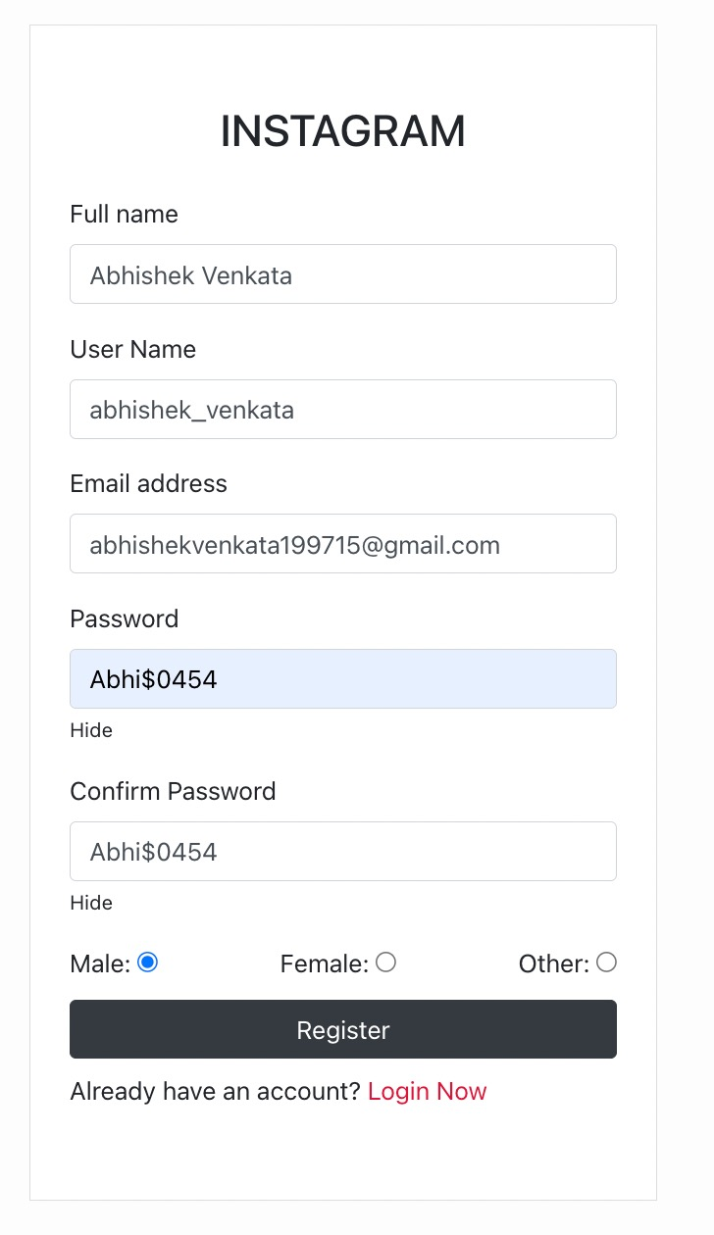
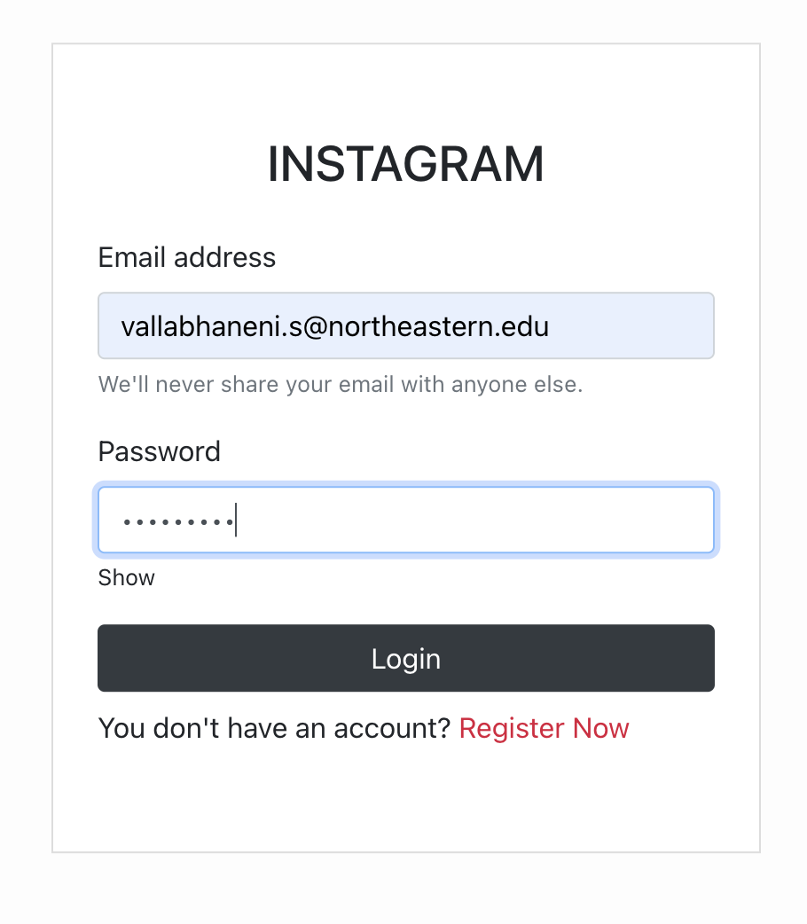
Screenshots of Instagram
User Login
Create new user

Slide 6
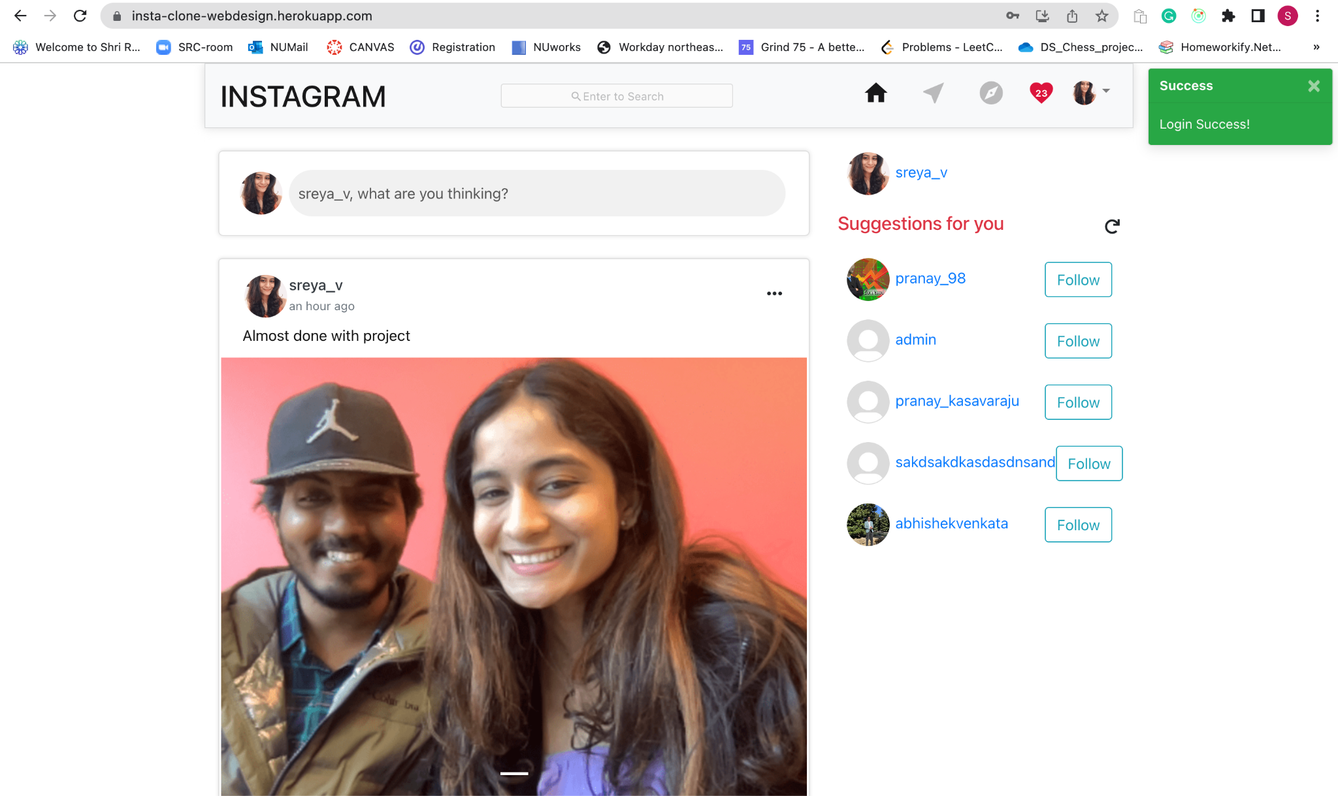
Home page/ successful login alert

Slide 7
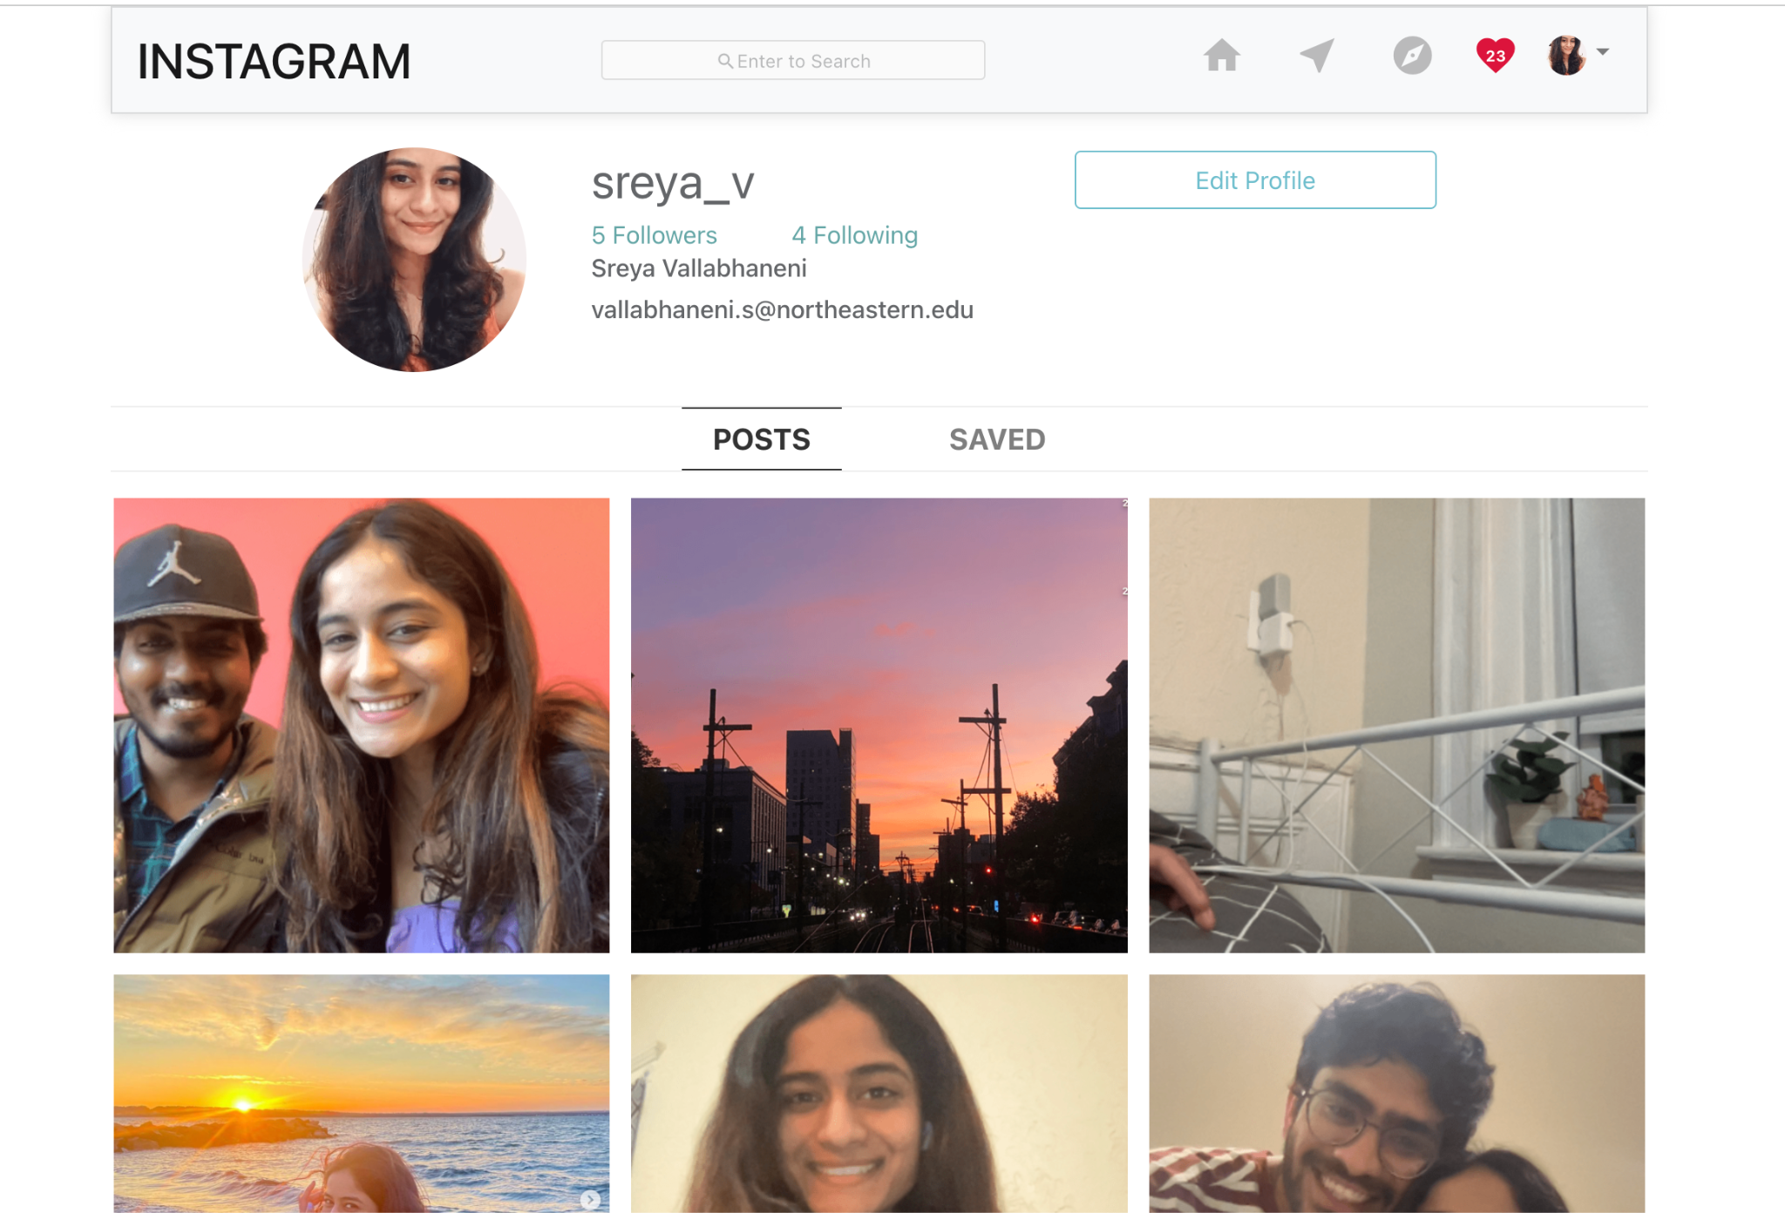
User Account

Slide 8
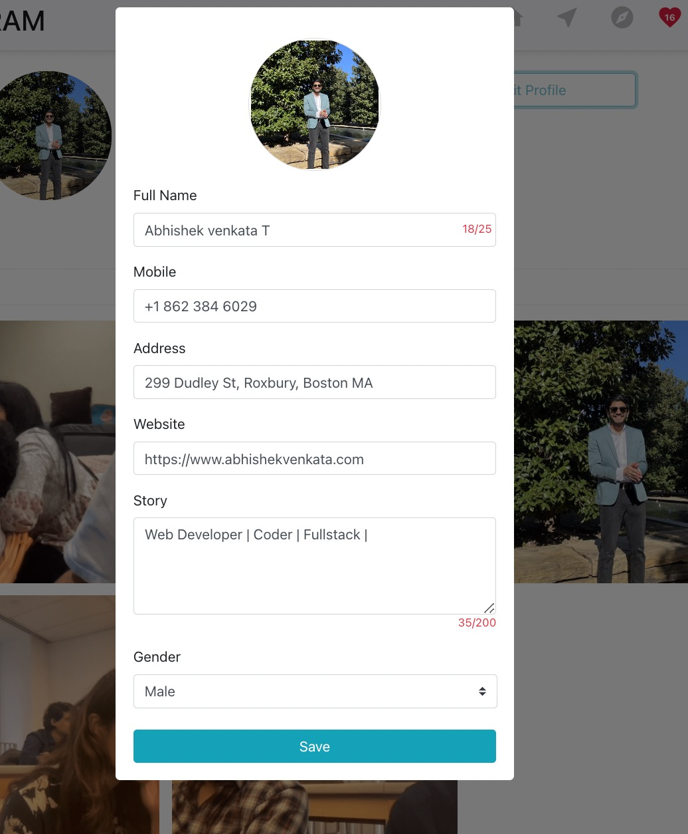
Edit information

Slide 9
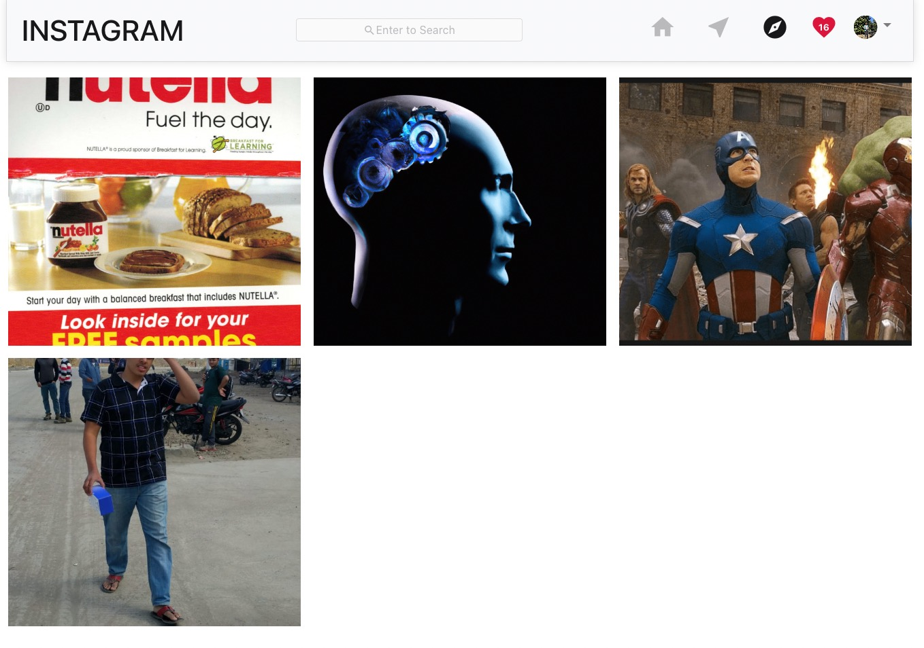
Discover option

Slide 10
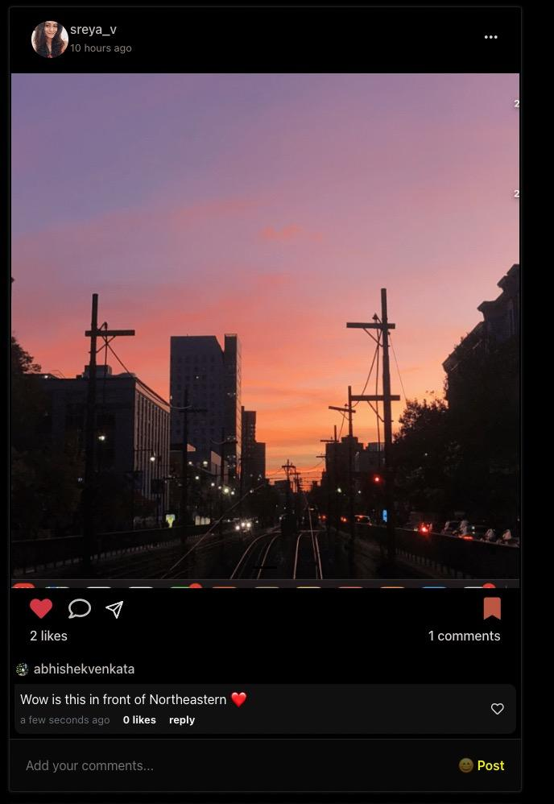
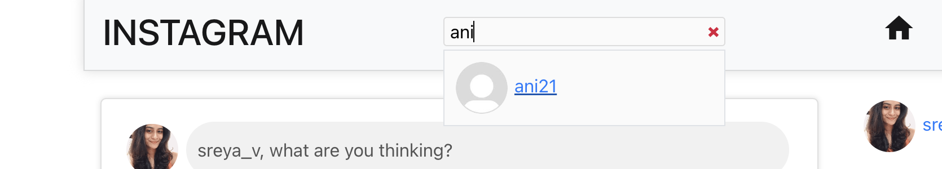
Search bar
Instagram Feed
Each post has option to like, comment or share to an external source, replies to comments are also enabled

Slide 11
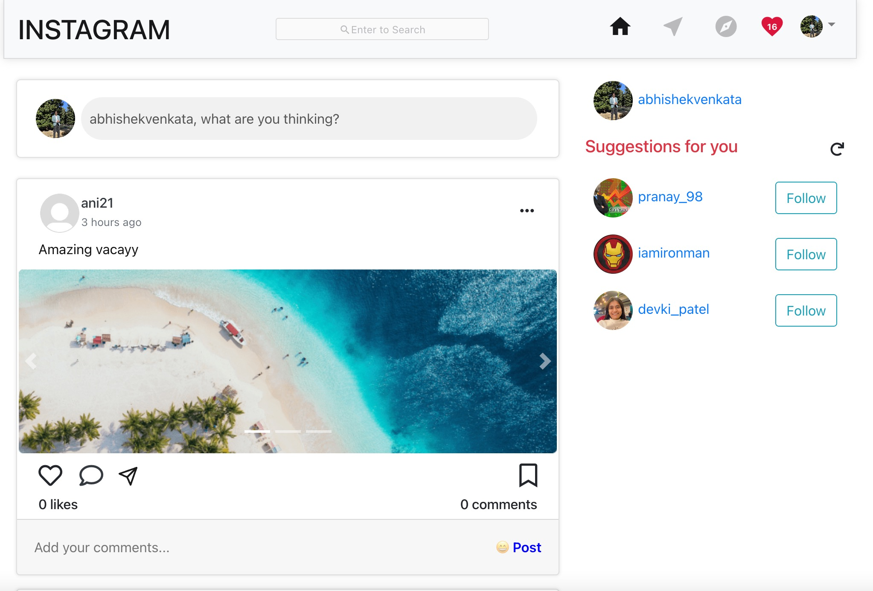
Suggestions For You

Slide 12
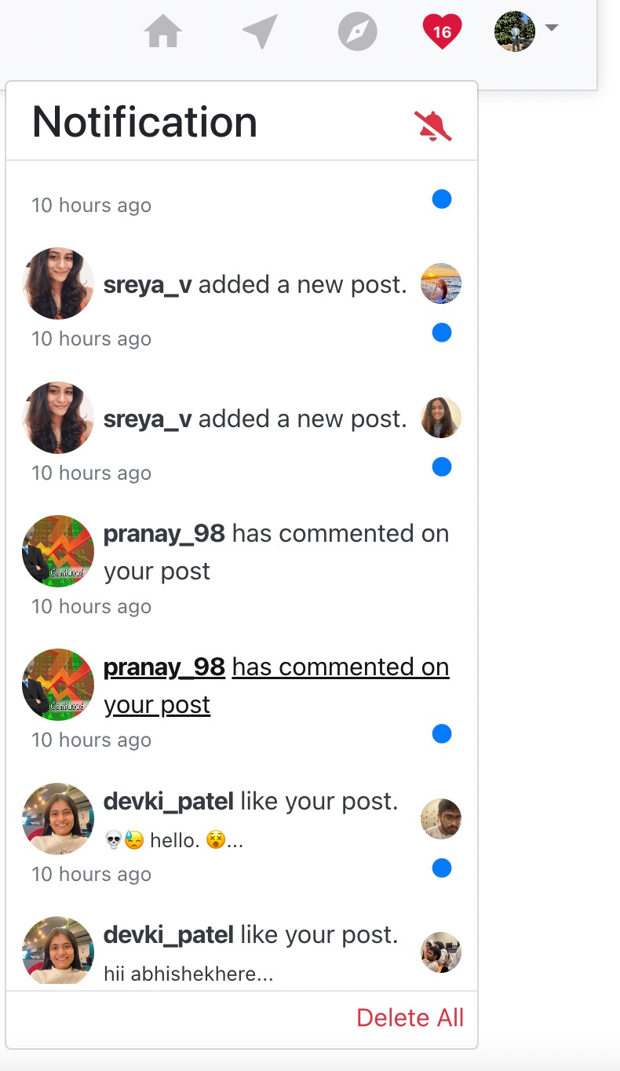
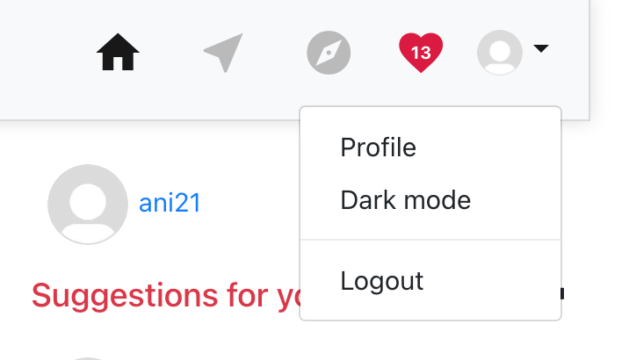
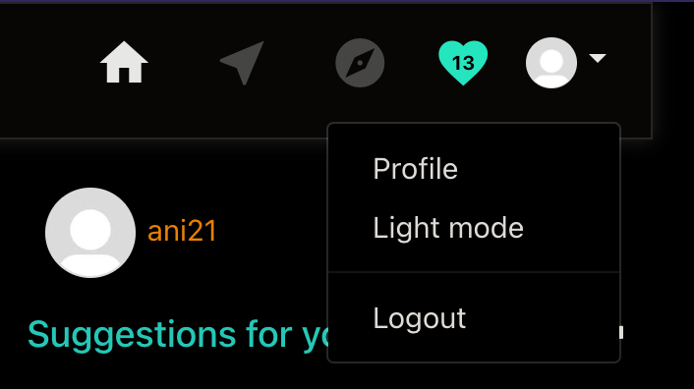
Drop down option for Profile and Dark/Light Mode
Notifications from followers

Slide 13
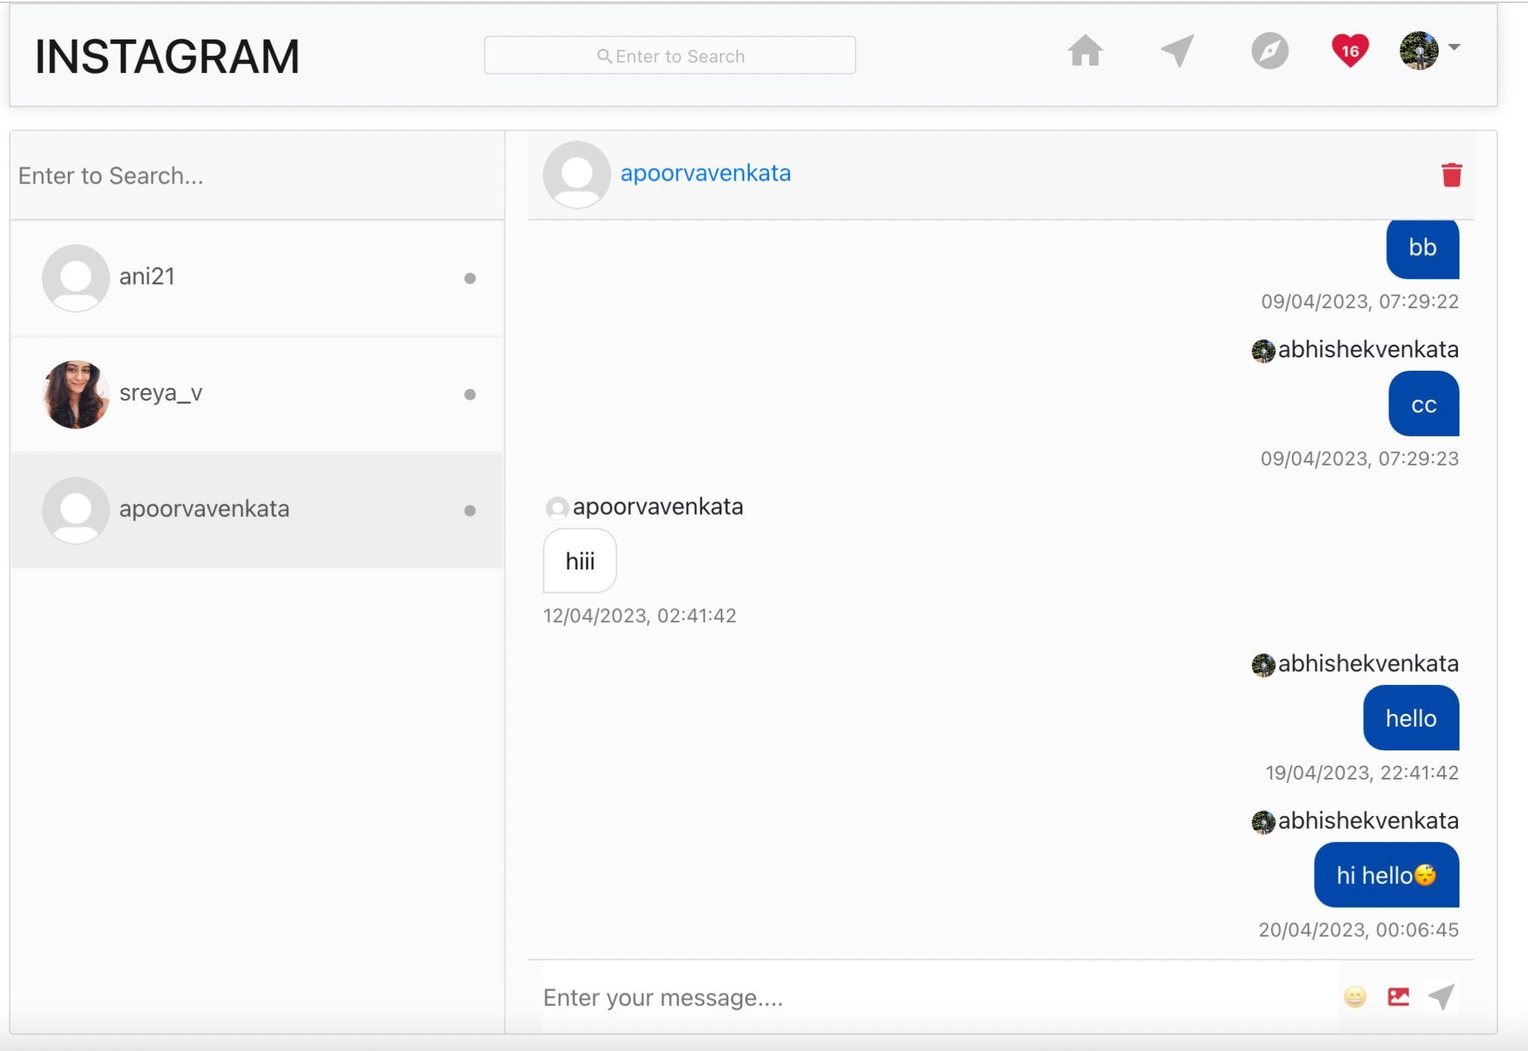
Messaging Page

Slide 14
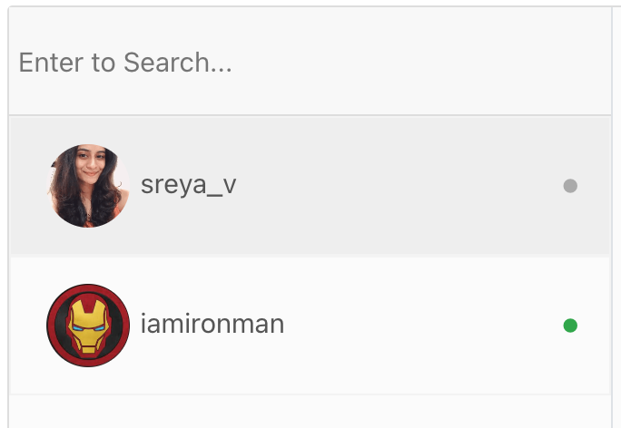
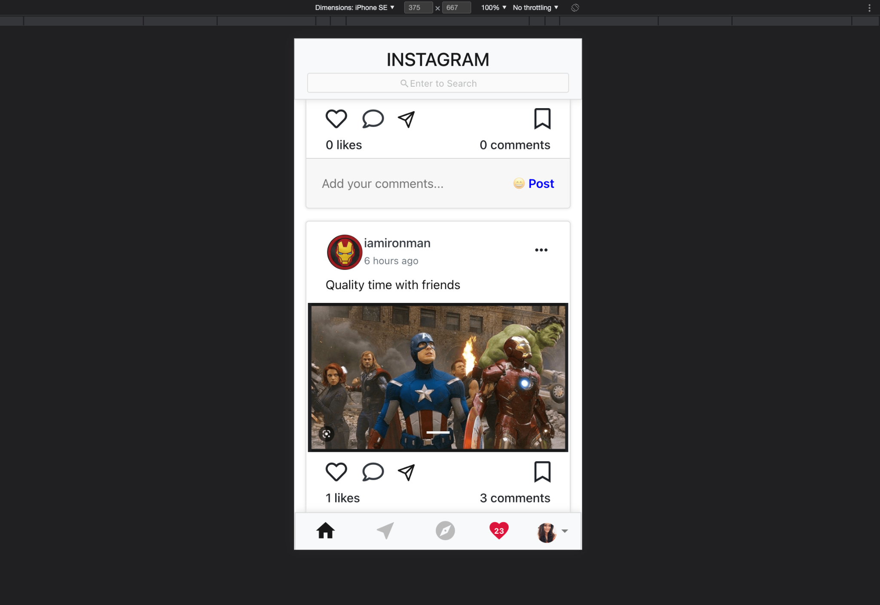
Online and Offline users
Mobile Responsive

Slide 15
REFERENCES
https://getbootstrap.com/docs/5.3/getting-started/introduction/
https://www.w3schools.com/react/default.asp
https://www.mongodb.com/basics/get-started
https://stackoverflow.com/questions/38549774/fetch-data-from-api-with-reactjs
https://legacy.reactjs.org/docs/components-and-props.html
https://socket.io/how-to/use-with-react

